Slide 1
Web Mapping

Slide 2
Web Map:
A map that is published and accessed via the internet, usually as part of web page.
World Wide Web (WWW) / Web
Defined as an information system where data can be access via the internet.
Huge change in communication sector
Advancement in computers and accesories
Roles of User has changed from Map Reader to Map User

Slide 3
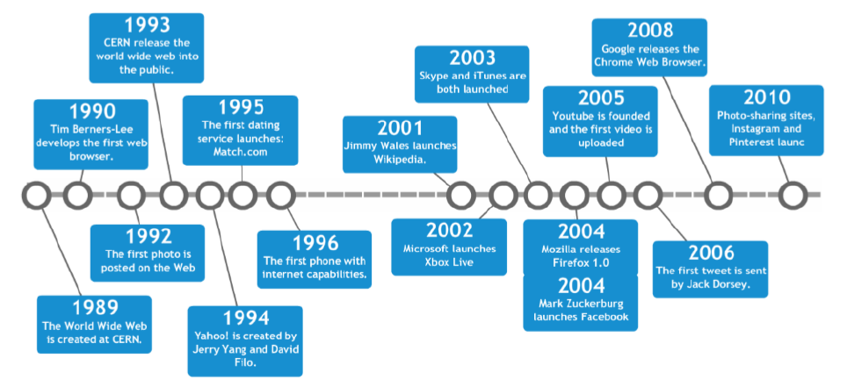
History of Web Map

Slide 4
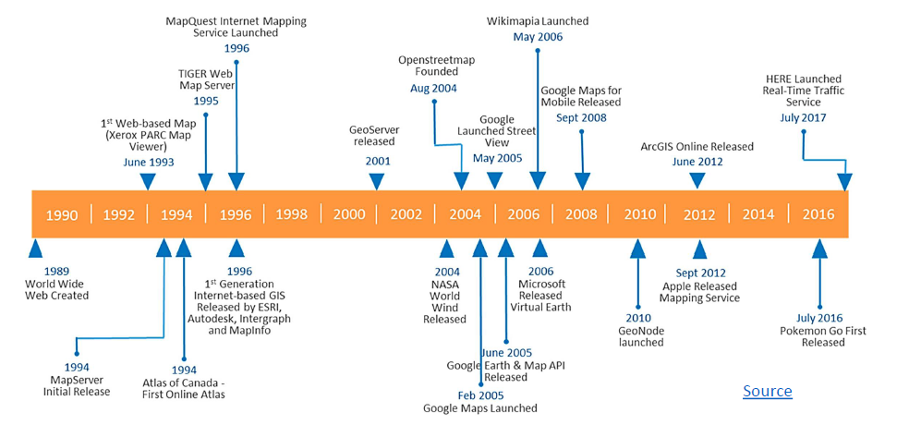
History of Web Map

Slide 5
Types of Web Maps

Slide 6
Static Maps
Maps that can be displayed on web and mobile devices without the aid of a mapping library or API.
Just a simple digital map loaded on the websites.
It is not interactive, which means no panning, zooming or changing map layers

Slide 7
Dynamic web maps:
web maps that change appearance as they are viewed by user as per their interest.
User can query , as per their interest and idea. They can search , zoom in and out…. Select some layers,
On this map, it is possible to place large amounts of markers and to link them with loaded data.
This type of visualization will be stored on a server of MapCreator; the so-called hosted solution.

Slide 8
Animated Maps
Animated mapping is the application of animation, either computer or video, to add a temporal component to a map displaying change in some dimension
Temporal and Non-Temporal Animation
https://www.flightradar24.com/27.71,85.32/10

Slide 9
Web Map Development
Hypermaps are defined as georeferenced multimedia map.
It is composed of maps of different formats, organized with superimposed layers.
Each layer presents a different map, depending on the level of zoom applied.

Slide 10
Interactive Web Maps
Interactive mapping involves using maps that allow zooming in and out, panning around, identifying specific features, querying underlying data such as by topic or a specific indicator (e.g., socioeconomic status), generating reports and other means of using or visualising select information in the map.
Interactive mapping uses the GIS (Global Information System) to show pinpoint data on a map.
Unlike static maps, interactive maps have the advantage of a number of features designed to improve the display of a large amount of complex data.

Slide 11
Colabrative Web Map
Collective approach of mapping
Data and layers are collected and updated from various users and developers.
OS Maps

Slide 12
Client Server Technology

Slide 13
Client Server Technology:
Client/ Server technology is a means for separating the functions of an application into two or more distinct parts.
Client/ server describes the relationship between two computer programs in which one program, the client, makes a service request from another program, the server, which fulfils the request.
The client presents and manipulates data on the desktop computer.
Mainly two types : Thin and Thick

Slide 14
Server-side Application (Thin client)
End users submit request for data and analysis to a web server. The server processes the requests and returns data or a solution to the remote client.
These applications do not require any installation of software on the client- side.
The complete processing is carried out on the server.
Lightweight and do not occupy any space on the client-side.
Can be accessed by any computer or mobile device that has internet access, making them very portable.
A thin client application is only as fast and reliable based on the user’s internet connection and the server’s bandwidth.

Slide 15
Client-side Application (Thick Client)
End users can perform some data manipulation and analysis locally on their own machines. (Thick Client)
The major processing is done at the client-side and involves only a periodic connection to the server.
Thick clients have several advantages – good architecture, decoupled design, offline access, increased flexibility, higher server capacity (allowing support for multiple users), and improved performance for multimedia applications that lead to better structure, modular caching, separating responsibilities, and creating more static assets.

Slide 16
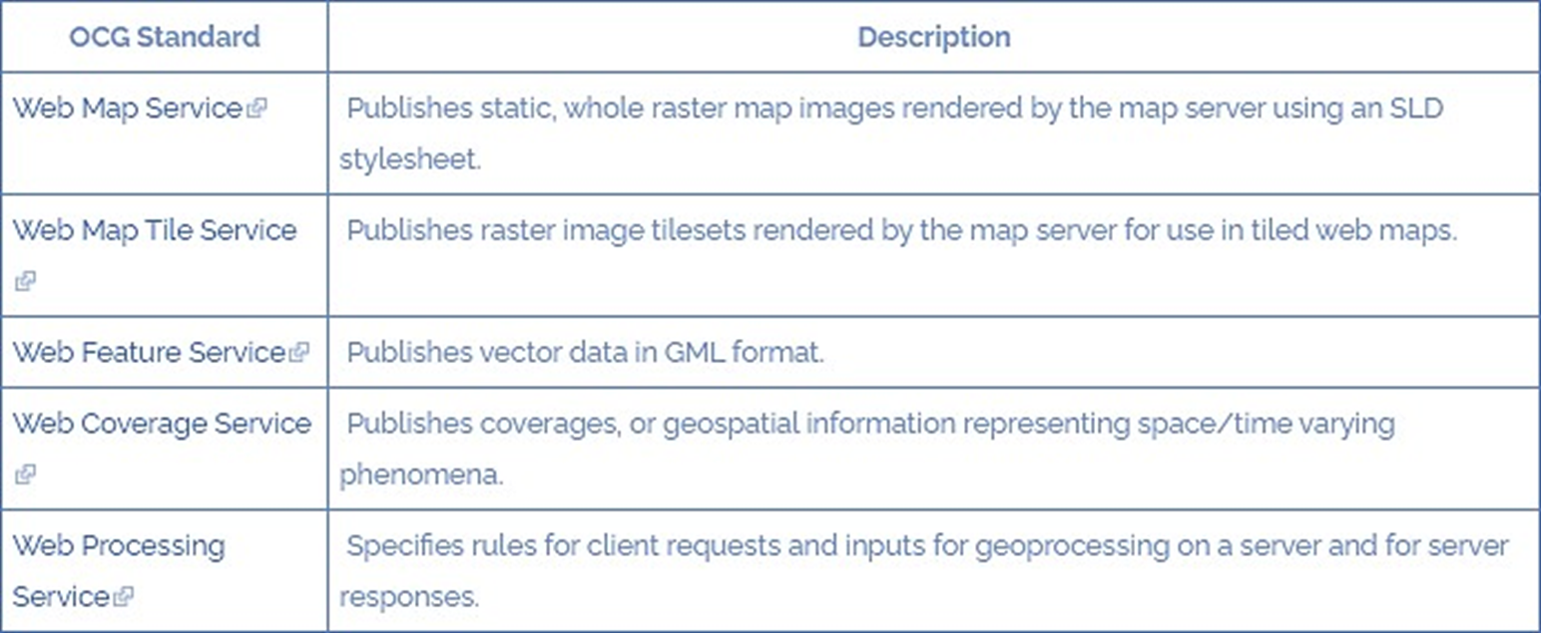
OGC Geospatial Web Services
Open Geospatial Consortium – 500 plus businesses, governments agencies, research organizations and universities united with a desire to make location information FAIR – Findable, Accessible, Interoperable, and Reusable.

